Slide 1


CITS1003 Introduction to Cybersecurity [8] Digital Forensics
Dr David Glance

Slide 2

A unit about cats cybersecurity
https://www.reddit.com/r/photoshopbattles/comments/
/ija3ze/psbattle_cat_dressed_as_detective_sherlock_holmes/

Slide 3
3 things
The stages of digital forensics
1
The legal basis
2
Its role in criminal cases
3

Slide 4
Digital Traces
Locard’s exchange principle:
Physical contact between objects inevitably results in the exchange of matter, leaving traces that can be analysed to (partially) reconstruct the event
All digital contact leaves traces:
Browser history
Logs (logins, logouts, other events)
File creation, modification dates
Document metadata such as author, version history
Backup files
Communications: email, messages

Slide 5
Digital Forensics
The discipline of collecting digital evidence that is related to an incident in such a way as to be able to be used in criminal and civil proceedings
Criminal investigations
Intelligence gathering
eDiscovery in relation to civil law
Incident response

Slide 6
Digital Forensics
Digital data may be present on a range of devices such as
Hard drives
Computer memory
Peripheral device memory (such as in printers) ,
Removable drives like USB drives
Smartphones
IoT,
Cars - through navigation and entertainment systems.

Slide 7
Digital Forensics
Collecting this data involves doing so in a way that maintains the integrity of the data and its associated metadata such as creation and modification times and dates
Digital forensics specialists use specific devices that can image a disk or extract memory without the possibility of writing to the disk at the same time. This prevents any metadata from being changed.

Slide 8
The Legal Basis for Gathering Evidence
In the US, 3 cases in the 1990s established the Daubert standard for scientific evidence in legal proceedings
The theoretical underpinnings of the methods must yield testable predictions by means of which the theory could be falsified.
The methods should preferably be published in a peer-reviewed journal.
There should be a known rate of error that can be used in evaluating the results.
The methods should be generally accepted within the relevant scientific community.
In the UK the Law Commission built on this:
No action taken by law enforcement should change data that may be subsequently relied on in court
People collecting data should be competent to do so
An audit trail that enables someone else to reproduce the results should be kept
There should be someone in charge to ensure that the law and these principles are kept
UK now requires accreditation ISO/IEC 17020/17025

Slide 9
Legal Issues with Digital Evidence
Proving attribution is sometimes hard
“Someone else used my WiFi”
Evidence was not tampered with or altered
Having correct search warrants
Searching for one thing and then discovering evidence for a different crime
Destruction of evidence by parties

Slide 10
Forensic Conceptual Models
State-centric vs History-centric
State-centric is a snapshot of the current system e.g. hard drive or even memory
Infer prior states from snapshot
History-centric (aka log-centric): timestamped events that may establish a full record of events
Computer OS logs, application logs, network traffic logs

Slide 11
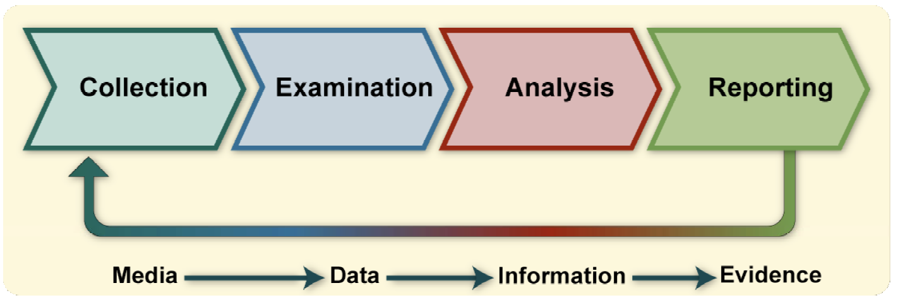
The Forensic Process
From NIST SP800-86 Guide to Integrating Forensic Techniques into Incident Response

Slide 12
Collection of Data
Establishing data provenance and maintaining integrity
Identify possible sources of data
Other than devices, there may be 3rd Party records of activity such as ISP metadata retention, mobile phone company records, social media company information
Securing devices before someone is able to delete files or tamper with evidence is critical – although it is often possible to recover files that the user has thought they deleted
Data may be in encrypted forms which are potentially recoverable through access to memory where it is held in plaintext, decryption by knowing the keys or through some other technique

Slide 13
Collection of Data
Data can be collected from live machines and also from disks and memory devices that are “dead”
Data is copied from storage and other devices in a bitwise manner i.e. getting an image of raw data
Usually done in 512 byte chunks that equate to a “sector” on a disk
This avoids changing the file system in any way during the reads
Can use a write-blocked device to copy data
We don’t use a logical data acquisition process using other layers to access or copy files
This presents some problems if the data is stored in proprietary way
Main decisions in data acquisition
Likely value of the data to achieve its objectives
Volatility being aware that data may disappear if machines are powered down, files may be updated etc
Focus on amount of effort required
Once data is acquired, needs to be verified

Slide 14
Examination
Use of tools to assist in examination of data of recovering files of interest,
Analysis of hard drives and smartphones: Autopsy/The Sleuth Kit
Memory Analysis: Volatility 3
Windows specific forensics: Arsenal Recon: Registry (Live and Hive), Disk Images, Hibernation files
Network Analysis: Wireshark
Mobile device forensics: iPhone Backup Analyzer, iExplorer, Autopsy, Scalpel, FTK Imager
Examination will use these tools to recover files and information from memory

Slide 15
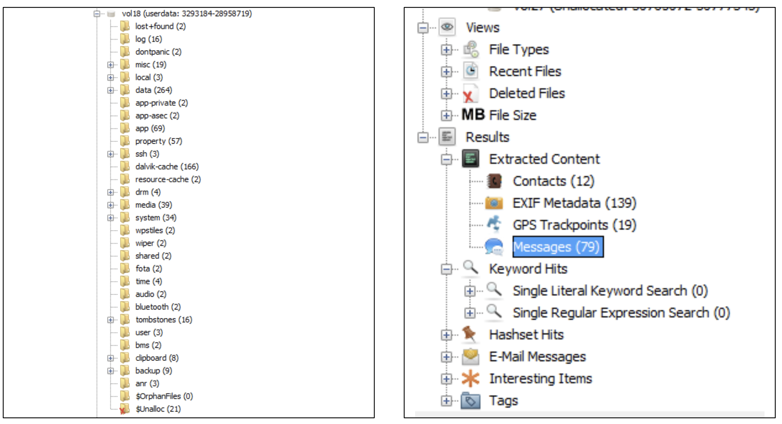
Android Examination

Slide 16
Android Examination II
In this case the data is presented in easy to access format and includes:
Files: organised by type and most recently accessed
Deleted files that are able to (in part or whole) be recovered
Extracted data:
Contacts
EXIF data: data embedded in images by cameras containing a image details, timestamp, camera information and location
GPS information: this can be obtained from Google and other services that store location history
Messages: SMS and other types of messages
Email
Documents

Slide 17
Analysis I
Analysis is going to be led by the crime being investigated
Attribution: attributing actions to an individual
Alibis and statements: cross-checking information provided by individuals with digital evidence
Intents: In addition to finding objective evidence of a crime, intent (legal term mens rea) can also be explored
Will examine evidence in the form of
Audio, images and video files

Slide 18
Analysis II
Evidence is accumulated that is related to the crime:
Timelines of activities
Supporting claimed timeline of events
Locations of suspects and defendants
Geolocated from images posted on social media
Geolocation and heartrate data from Fitbit data
Activities on the computer
Search history:
Searching for means of committing crimes e.g. poisoning, explosives
Network data
Exfiltration of data in IP theft

Slide 19
File System Analysis: Deleted Files
Searching for deleted files that are deallocated but not erased:
Most file systems use a table that holds information about where files are stored on the disk. They are stored in clusters and may not be contiguous
When a file is deleted, only the entry in the table is overwritten and so the data for the file remains on disk unless overwritten by subsequent file operations
A secure erase adds the steps of writing a sequence of 0s and 1s to the disk where the file is stored to completely obliterate the file – on a magnetic disk this may still be recoverable if not done comprehensively

Slide 20
File System Analysis: Slack Space
Slack Space
When disk space is allocated to a file it is done in 512 byte sectors. If the file does not fill the available space there is space left over – slack space
This may contain left-over remnants of other files and so contain valuable information
Alternate Data Streams
Windows NTFS allows data to be allocated within a file using a stream and so only the default stream is normally seen
It can be used to hide data from casual view and also to hide malware
Hidden Files
Not strictly hidden but have the attribute set so need to be explicitly referenced using the hidden option on command tools

Slide 21
Reverse Engineering
In some cases, malware collected may be unknown and working out how they work is called reverse engineering (the code is reverse engineered from the binary data in the program)
Malware employs evasion techniques to prevent reverse engineering and so it is challenging to do this
In 2017, Marcus Hutchins found a web domain in the ransomware WannaCry during the attack that when registered and set up caused WannaCry to stop attacking – it was a kill switch. After registering it however, it came under attack from a DDoS from the Mirai botnet
Incidentally, WannaCry exploited two vulnerabilities in Windows called DoublePulsar and EternalBlue that had been stolen from the NSA

Slide 22
Memory capture and analysis
Can capture memory on machines using tools such as AVML (https://github.com/microsoft/avml) or FTK Imager that produces a memory snapshot
Using a memory analysis tool Volatility, we can analyse the image created in the previous step.
To process an image with Volatility we need to specify the profile of the memory image which matches the operating system version of the memory dump
You can then analyse the dump for artifacts using a set of plugins that are available to read:
Network information
Process information: detect if malware was running
Kernel modules that were loaded
Files in use by processes
Command line commands and output

Slide 23
Memory capture and analysis II
List the processes that were running and search for anything unusual such as malware
Dump the process and associated memory in order to analyse it further
Look for strings in the process that help identify malware
Identify user credentials such as usernames and passwords
Other details
Dump the files that are open in memory to examine the contents
Can read contents of files, registry, clipboard, history of commands typed in shells or cmd.exe and output of those commands
Network information will say where and with who the machine was communicating
Malware contacting command and control servers
Data being exfiltrated

Slide 24
Images
Image files come in a variety of different formats but contain
Formats include JPEG, TIFF, GIF, BMP, PNG
Data: pixels which are represented by n bits to represent amount of red, green and blue
Data can be raw or compressed using lossless or lossy compression
Data can be held as a raster format or vector format
Image files may contain EXIF (Exchangeable Image File Format) data that contains information about the camera that took the image, the image details, date and time and most importantly geolocation data

Slide 25
Forensic Examination of Images
Establishing image authenticity (Photoshopping, Deep Fakes or CGI)
Some images may not be illegal if they are “representative”
Establishing image content evidence:
Landmarks (e.g. apartment blocks, churches, schools)
Visible languages (e.g. shops, road signs, road markings)
Topography (e.g. hills, mountains, waterfalls)
Street furniture (e.g. benches, bins, bollards)
Look for illegal images e.g. child pornography

Slide 26
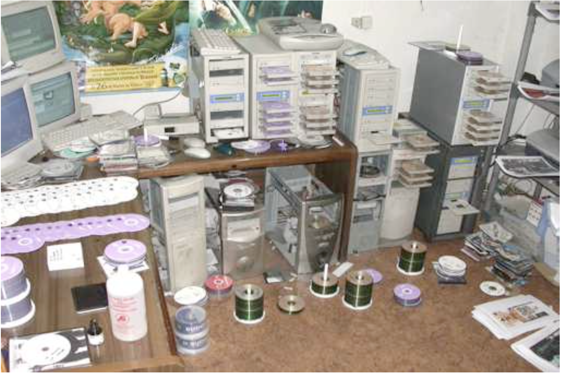
Illegal CD Duplication Factory

Slide 27
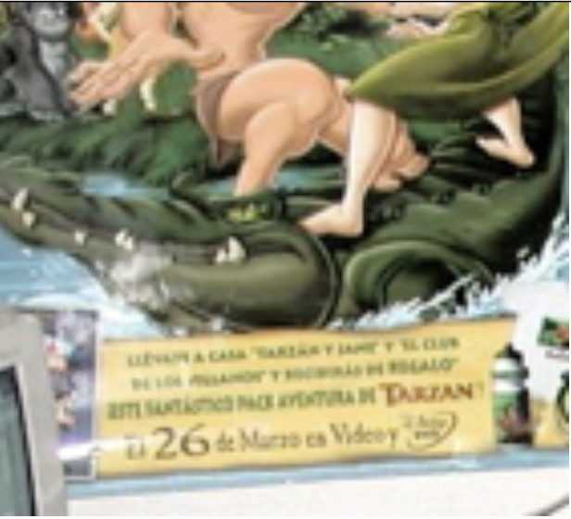
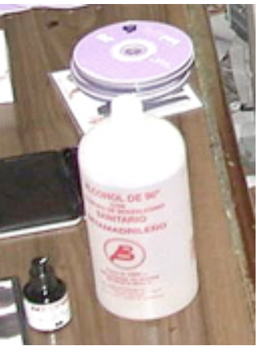
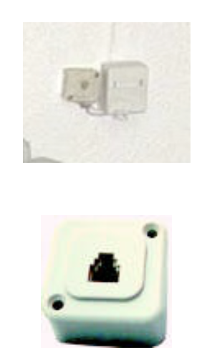
Illegal CD Duplication Factory
Alcohol bottle manufactured in Madrid
Telephone connector and spare part
Suggesting installed for computer
Poster in Spanish for Tarzan movie on the 26th March
Krawetz, N (2008) Black Hat Briefings DC 2008

Slide 28
Image Analysis Techniques
Variety of methods of analysing images
Principle Component Analysis (PCA)
Error Level Analysis (ELA)
Each time a JPEG is saved it creates errors which gets progressively less with each save
ELA involves saving image to known level and then detecting the error difference
New changes are impacted more than the original

Slide 29
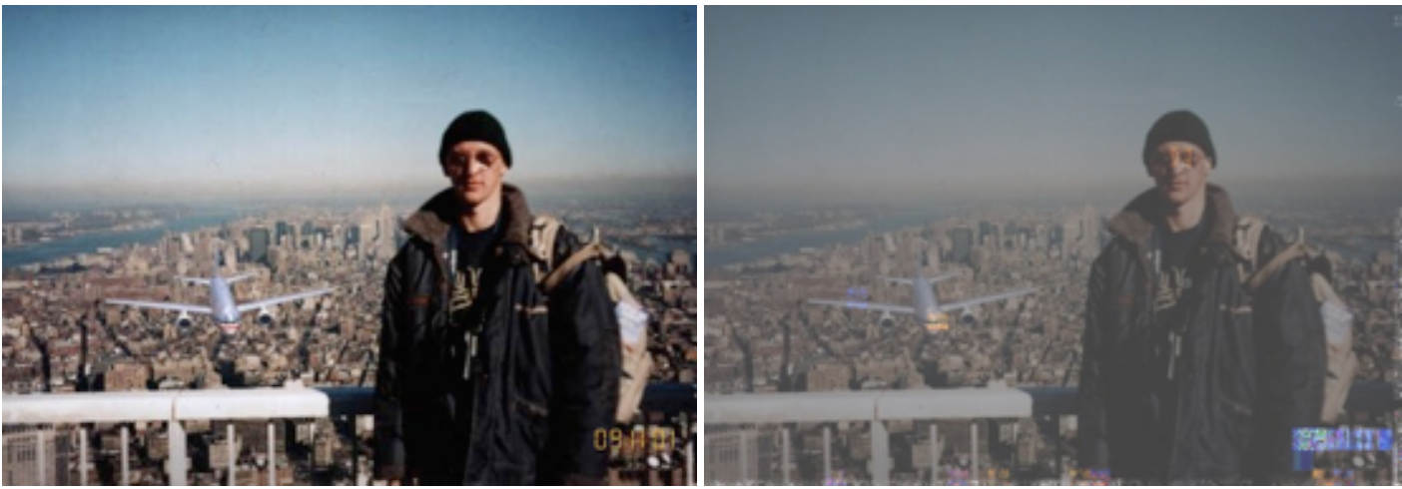
ELA on WTC Crash Photo
Krawetz, N (2008) Black Hat Briefings DC 2008

Slide 30
Steganography
Steganography is Greek for steganos (στεγανός) which means “covered” and graphia (γραφή), which means “writing”
Message is hidden in another medium such as images, audio or webpage so that the message is hidden even in plain view
The other medium is the carrier file
Two forms
Insertion: hidden text is added to the existing carrier
Substitution: bits of the carrier are replaced with the bits from the message

Slide 31
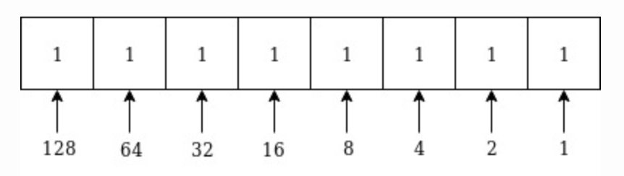
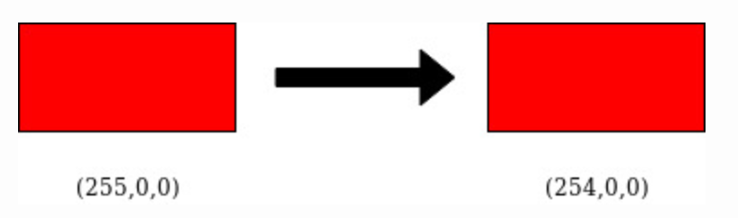
LSB Substitution
In a byte, the bit representing 1 is the least significant bit (LSB)
128 is the most significant bit (MSB)
We can change the bit without changing the colour to the human eye

Slide 32
Example
01010010 01001010 10010111 11001100 11010101 01010111 00100110 01000011
To hide the letter Z whose ASCII code is 10110101
01010011
01001010
10010111
11001101
11010100
01010111
00100110
01000011

Slide 33
Steganalysis
Steganalysis approaches:
Steganography-only attack: The steganography medium is the only item available for analysis.
Known-carrier attack: The carrier and steganography media are both available for analysis.
Known-message attack: The hidden message is known.
Chosen-steganography attack: The steganography medium and algorithm are both known.
Chosen-message attack: A known message and steganography algorithm are used to create steganography media for future analysis and comparison.
Known-steganography attack: The carrier and steganography medium, as well as the steganography algorithm, are known.
Can try and find the tool that was used by trial-and-error (brute force) or use tool that will look for steg program signatures (StegSpy)
If the original image is available, there may be a difference in size and hash value
Complex analysis can look at frequency distributions of pixels
Neural networks can be used

Slide 34
Use in Crime
Claimed that Osama bin Laden and members of al-Qa’ida used images via email and websites
In 2010 11 alleged Russian spies (sleepers) used steganography to communicate with their controllers (SVR) in Russia. The software used was proprietary and allegedly supplied by the SVR.
Used to hide malware because it is hard to detect when downloaded
Exfiltrate data – used in industrial espionage
2017 in the US Dmitry Sazonov tried to steal code for a trading platform of his employer. He used steganography to hide code in PDF files

